Slide 1
Detecting Exoplanets and recovering Parameters
A short recap of my work in week 5/6

Slide 2
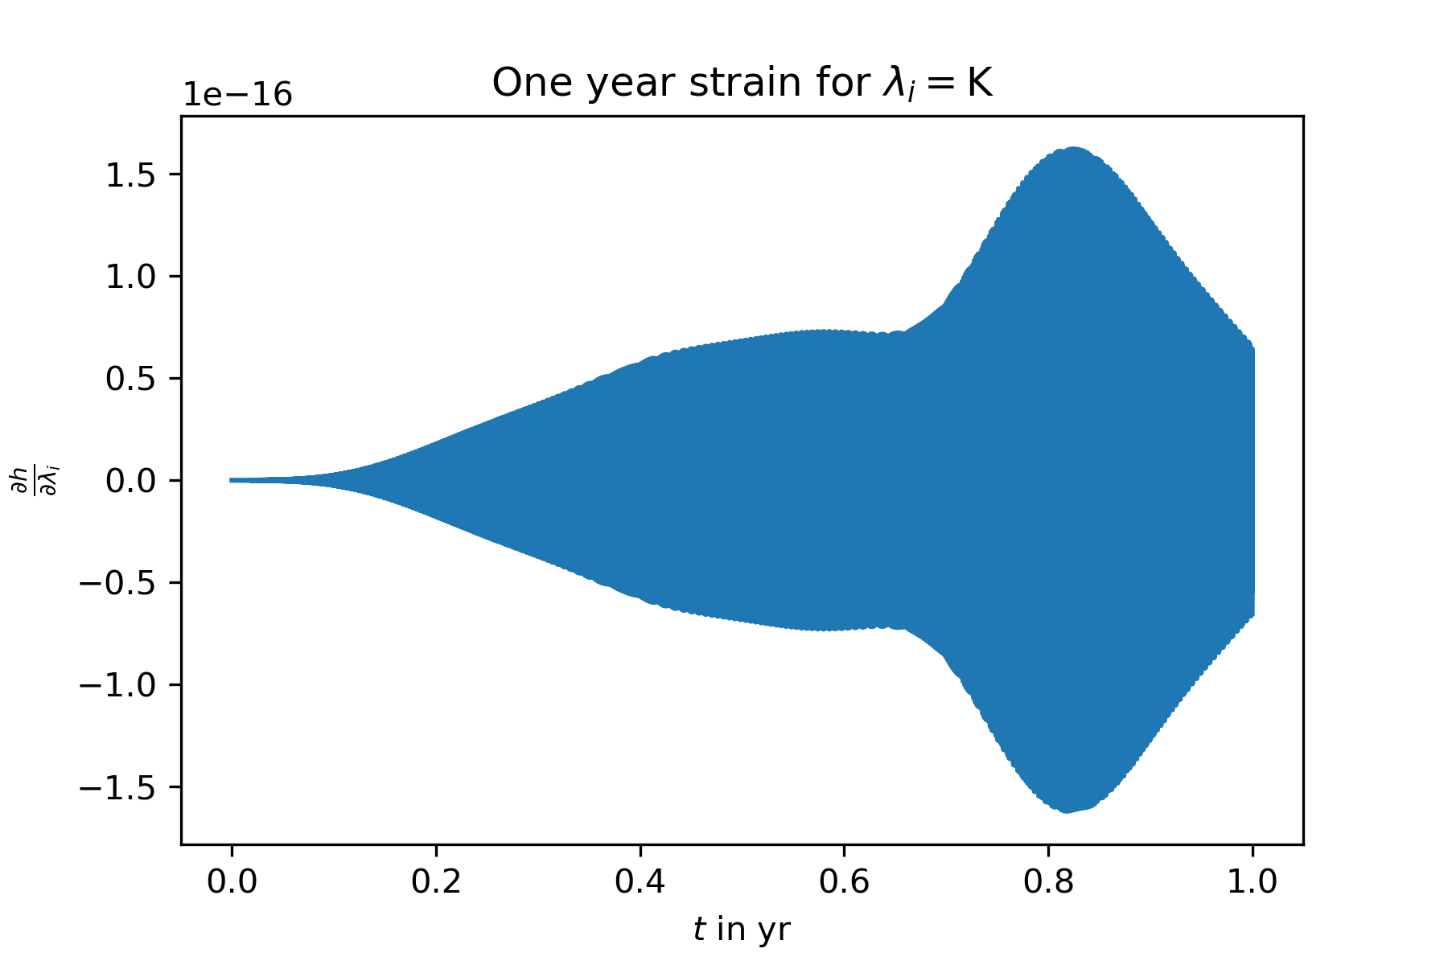
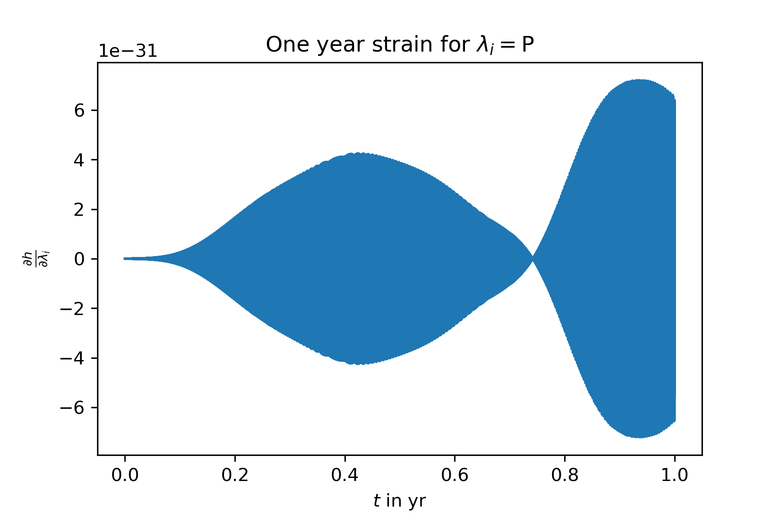
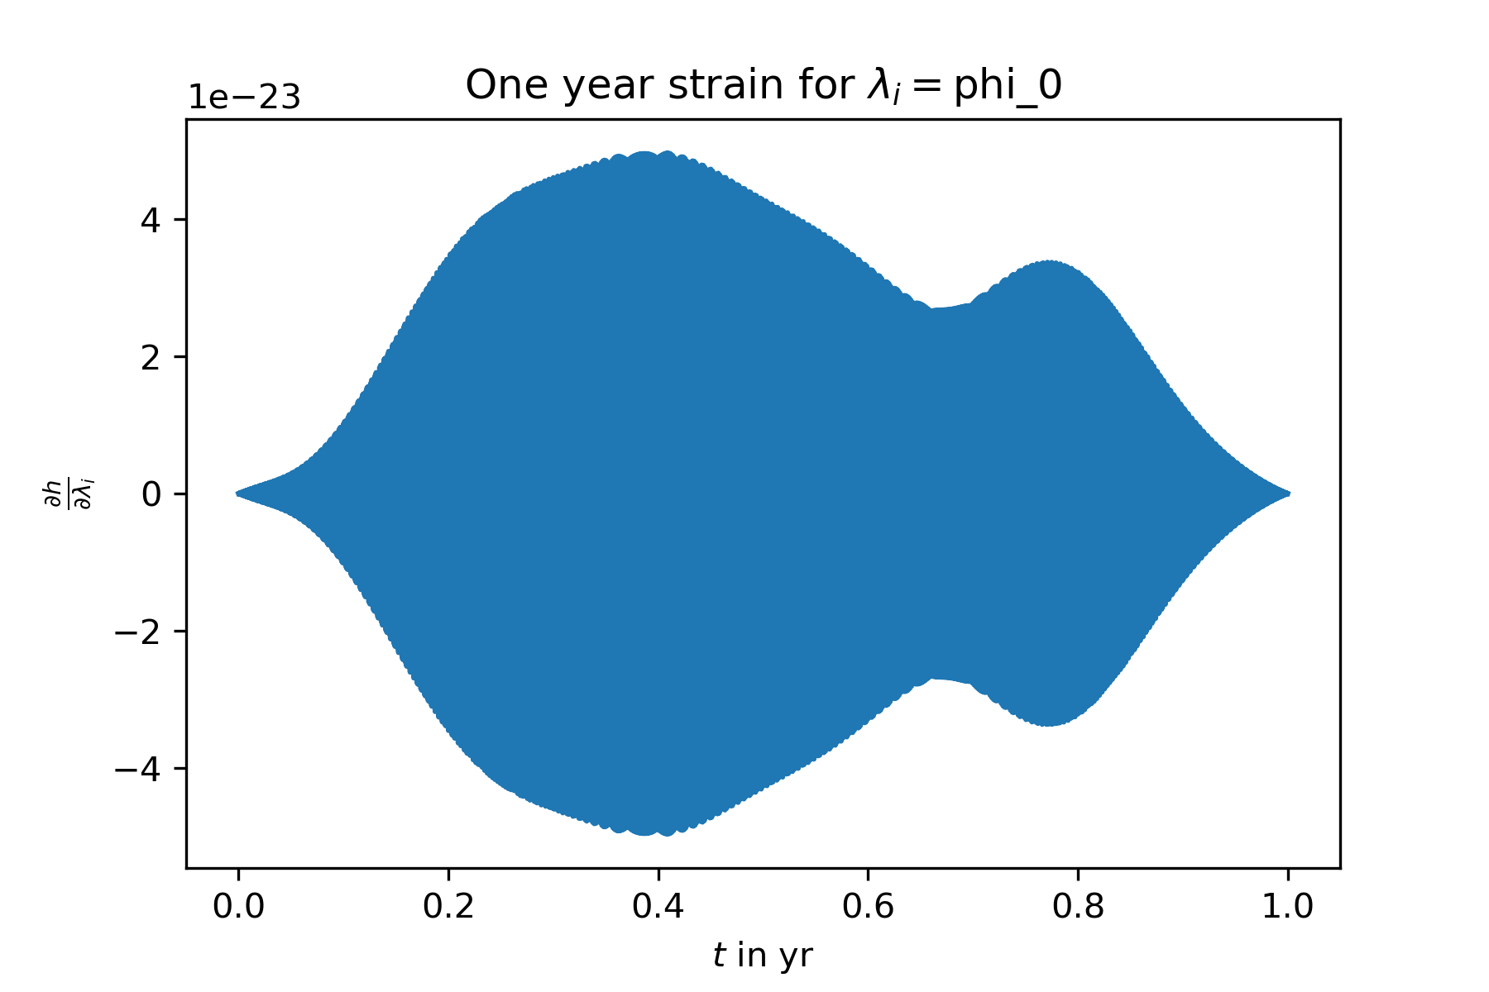
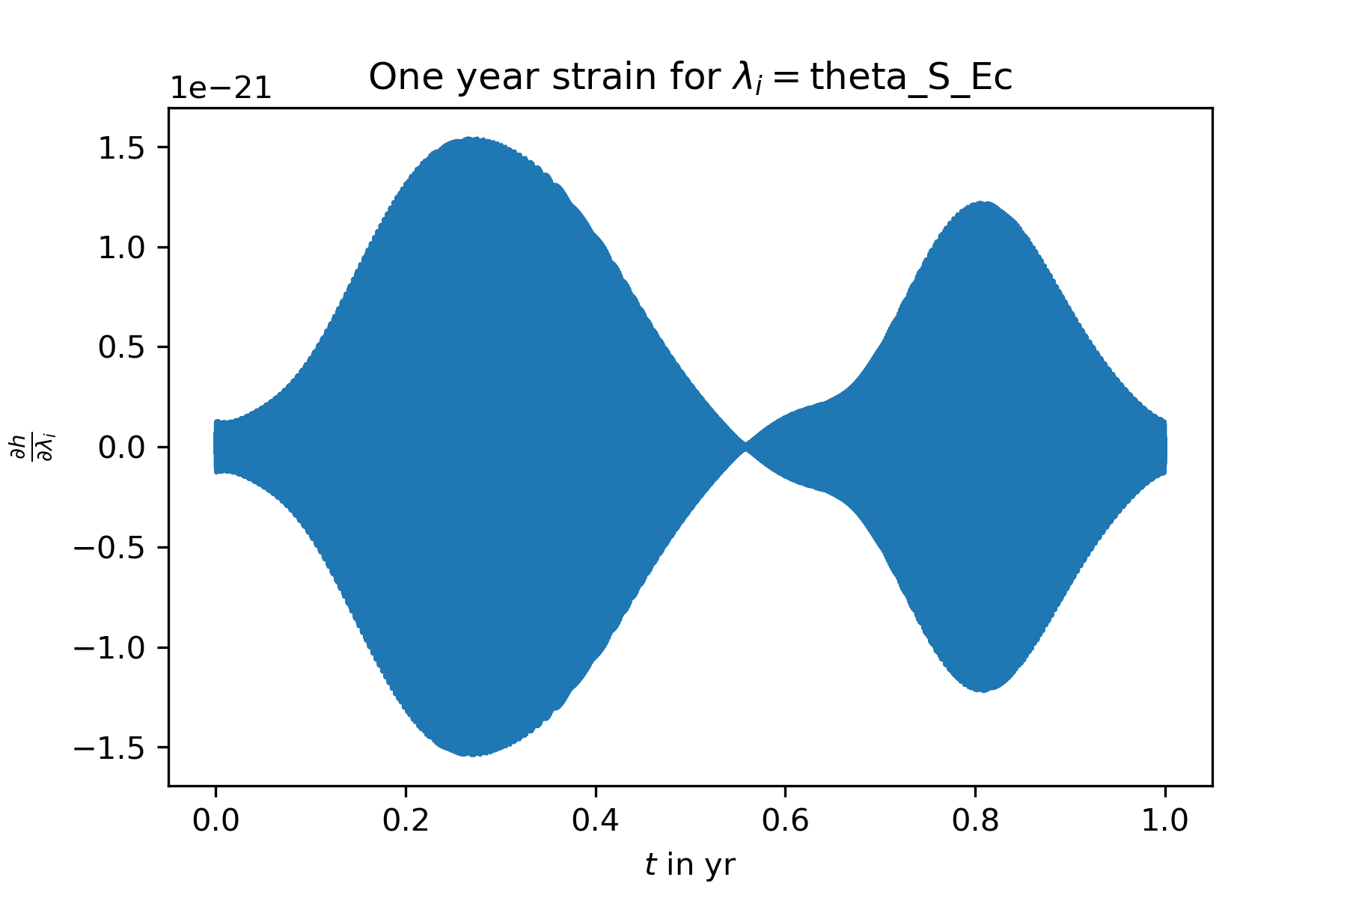
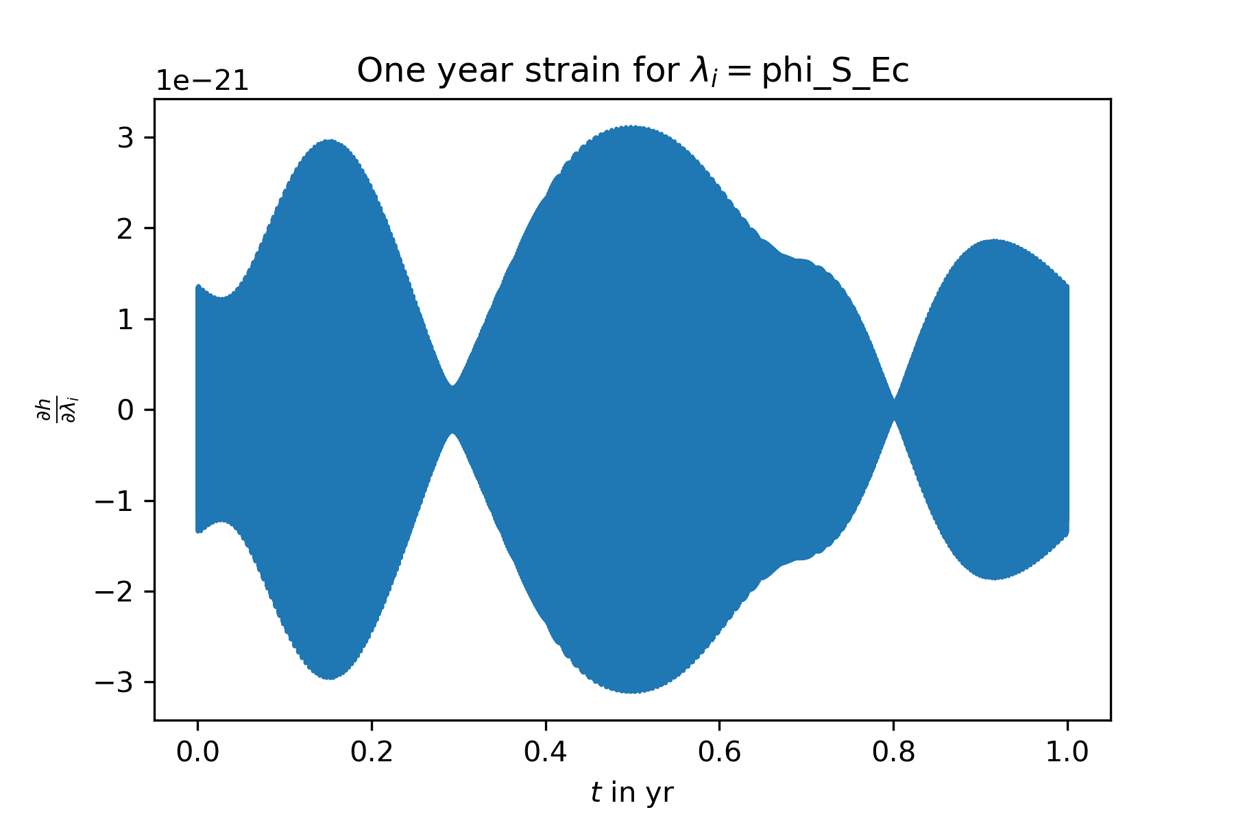
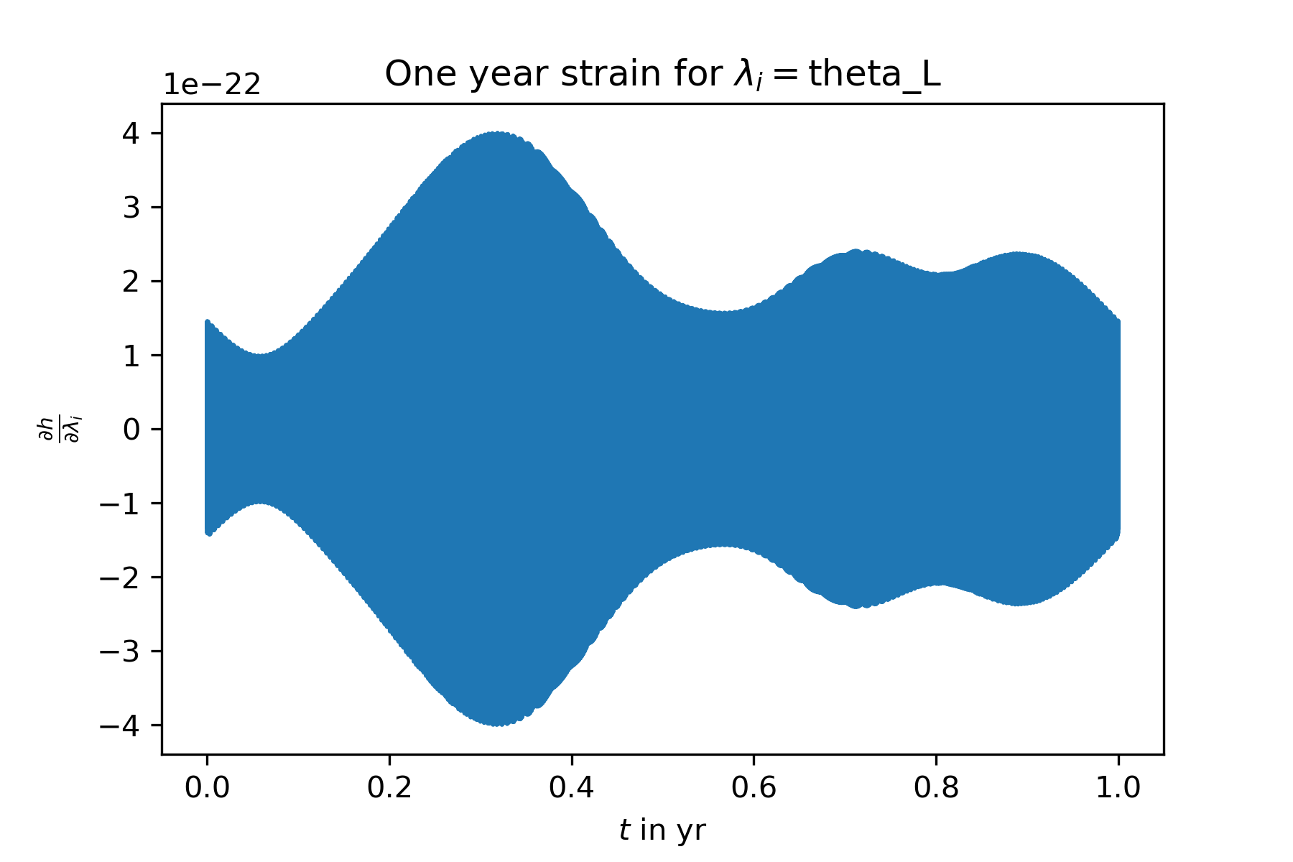
The derivatives $\frac{∂h_{α}}{∂λ_{i}}$ look good, compare the analytic derivatives of the exoplanet par‘s (above) with the numerical derivatives of the position par‘s (below) – same structure: envelope * oscillating function

Slide 3
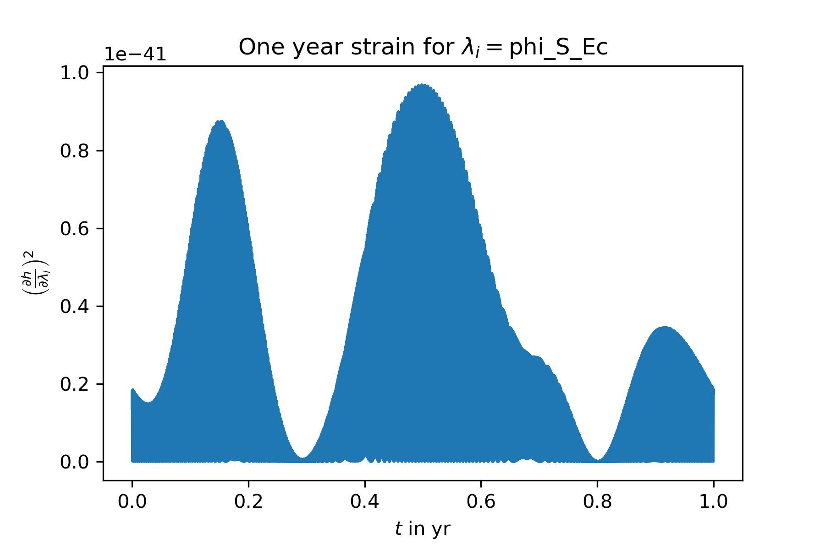
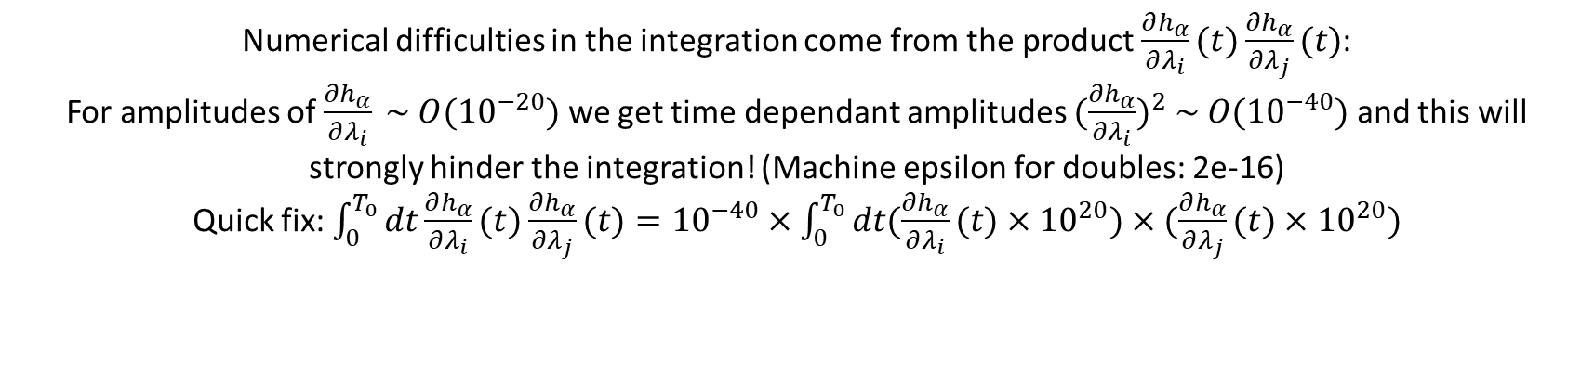
Numerical difficulties in the integration come from the product $\frac{∂h_{α}}{∂λ_{i}}(t)\frac{∂h_{α}}{∂λ_{j}}(t)$:
For amplitudes of $\frac{∂h_{α}}{∂λ_{i}} \sim O({10}^{−20})$ we get time dependant amplitudes ${(\frac{∂h_{α}}{∂λ_{i}})}^{2} \sim O({10}^{−40})$ and this will strongly hinder the integration! (Machine epsilon for doubles: 2e-16)
Quick fix: $\int_{0}^{T_{0}}{dt\frac{∂h_{α}}{∂λ_{i}}(t)\frac{∂h_{α}}{∂λ_{j}}(t)}={10}^{−40}×\int_{0}^{T_{0}}{dt(\frac{∂h_{α}}{∂λ_{i}}(t)×{10}^{20})×(\frac{∂h_{α}}{∂λ_{j}}(t)}×{10}^{20})$

Slide 4
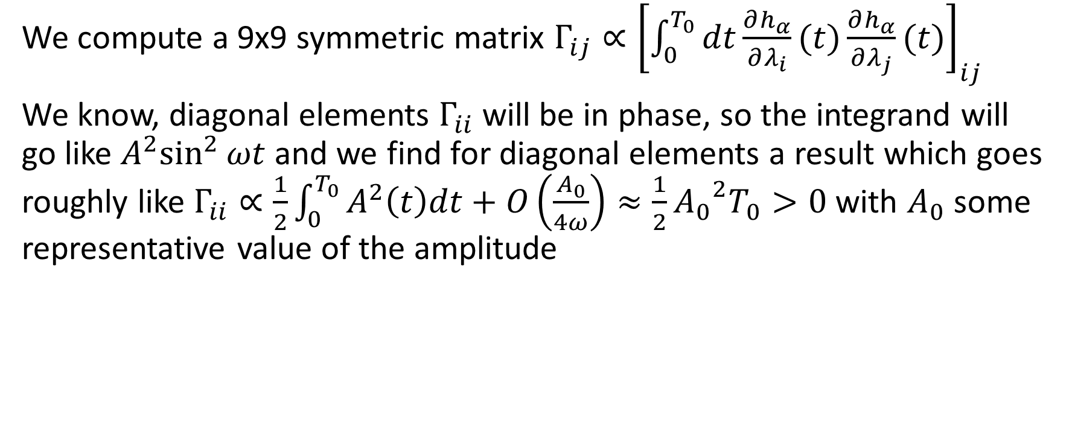
A new problem has approached
We compute a 9x9 symmetric matrix $Γ_{ij}∝{\left[\int_{0}^{T_{0}}{dt\frac{∂h_{α}}{∂λ_{i}}(t)\frac{∂h_{α}}{∂λ_{j}}(t)}\right]}_{ij}$
We know, diagonal elements $Γ_{ii}$ will be in phase, so the integrand will go like ${A^{2}sin}^{2}{ωt}$ and we find for diagonal elements a result which goes roughly like $Γ_{ii}∝\frac{1}{2}\int_{0}^{T_{0}}{A^{2}\left(t\right)dt}+O\left(\frac{A_{0}}{4ω}\right)≈\frac{1}{2}{A_{0}}^{2}T_{0}>0$ with $A_{0}$ some representative value of the amplitude

Slide 5
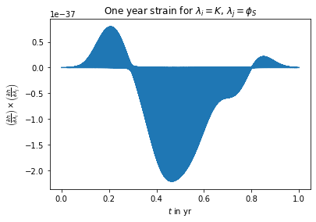
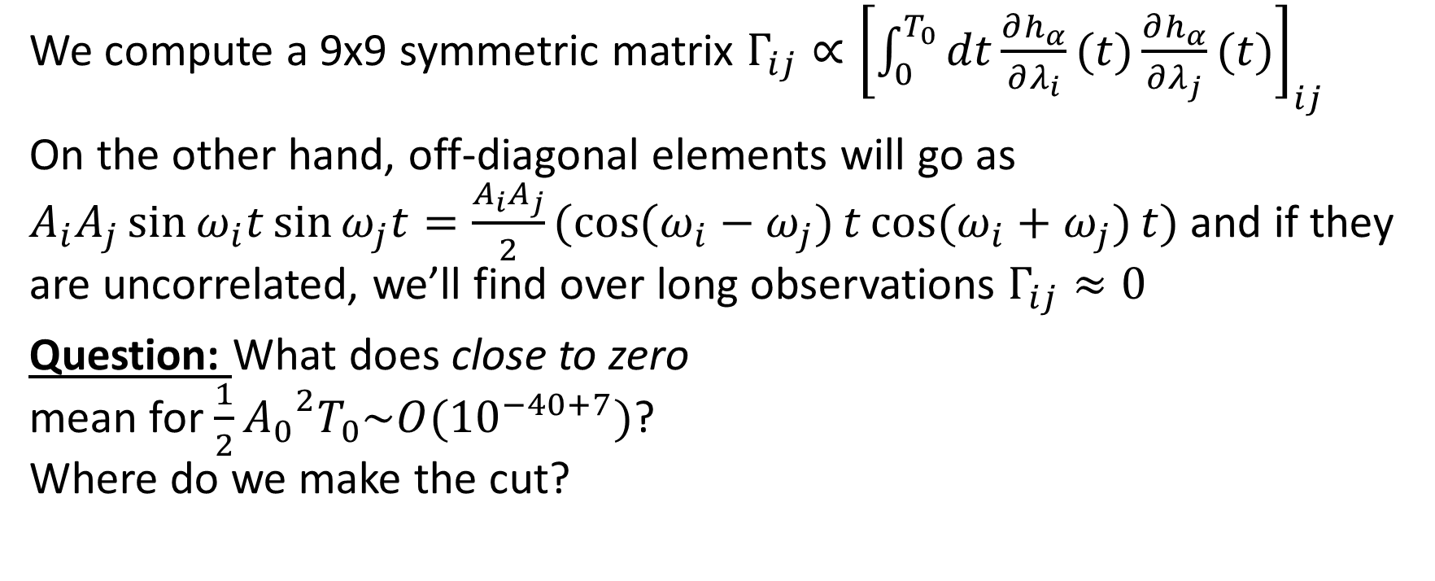
A new problem has approached
We compute a 9x9 symmetric matrix $Γ_{ij}∝{\left[\int_{0}^{T_{0}}{dt\frac{∂h_{α}}{∂λ_{i}}(t)\frac{∂h_{α}}{∂λ_{j}}(t)}\right]}_{ij}$
On the other hand, off-diagonal elements will go as $A_{i}A_{j}\sin{ω_{i}t}\sin{ω_{j}t}=\frac{A_{i}A_{j}}{2}(\cos{(ω_{i}−ω_{j})}t\cos{(ω_{i}+ω_{j})}t)$ and if they are uncorrelated, we’ll find over long observations $Γ_{ij}≈0$
Question: What does close to zero mean for $\frac{1}{2}{A_{0}}^{2}T_{0}\sim O({10}^{−40+7})$? Where do we make the cut?

Slide 6
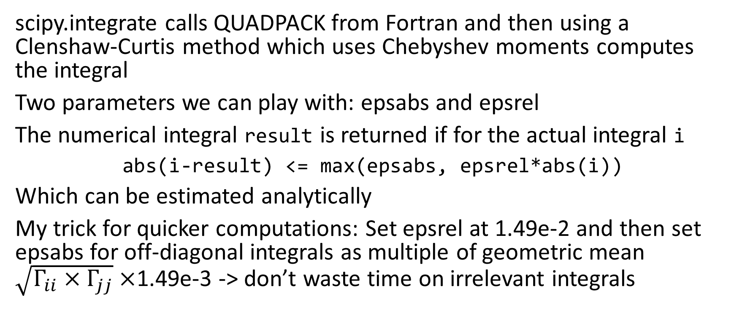
A short recap on numerical integration
scipy.integrate calls QUADPACK from Fortran and then using a Clenshaw-Curtis method which uses Chebyshev moments computes the integral
Two parameters we can play with: epsabs and epsrel
The numerical integral result is returned if for the actual integral i
abs(i-result) <= max(epsabs, epsrel*abs(i))
Which can be estimated analytically
My trick for quicker computations: Set epsrel at 1.49e-2 and then set epsabs for off-diagonal integrals as multiple of geometric mean $\sqrt{Γ_{ii}×Γ_{jj}}×$1.49e-3 -> don’t waste time on irrelevant integrals

Slide 7
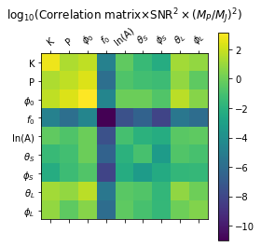

Findings
Looking at the correlation matrix for the 9 parameters of interest:
I again used the same position as Cutler, $f_{0}$ = 10 mHz and P = 2 yr
We can easily discard the $f_{0}$fit, as the determination of the GW frequency isn‘t very problematic

Slide 8
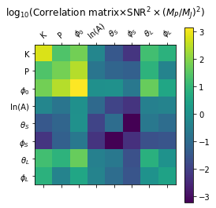
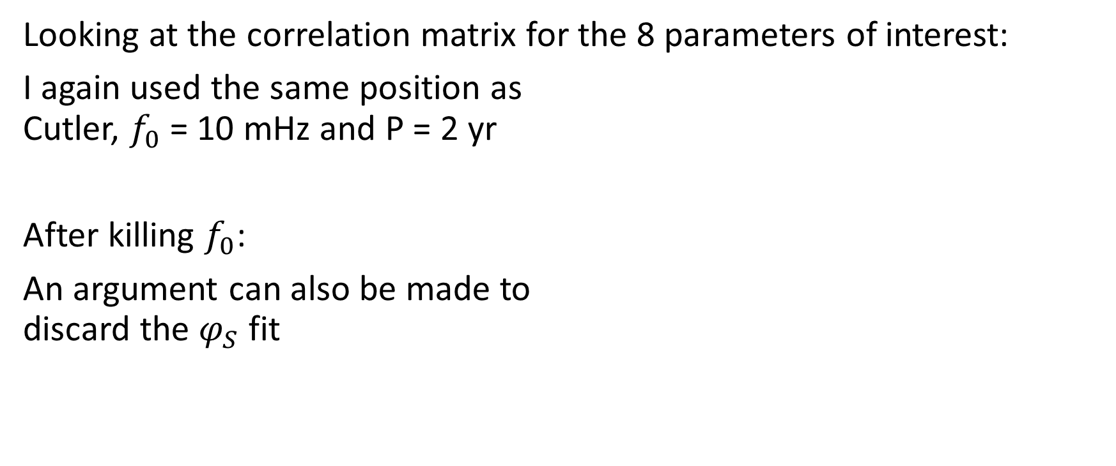
Findings
Looking at the correlation matrix for the 8 parameters of interest:
I again used the same position as Cutler, $f_{0}$ = 10 mHz and P = 2 yr
After killing $f_{0}$:
An argument can also be made to discard the $φ_{S}$ fit

Slide 9
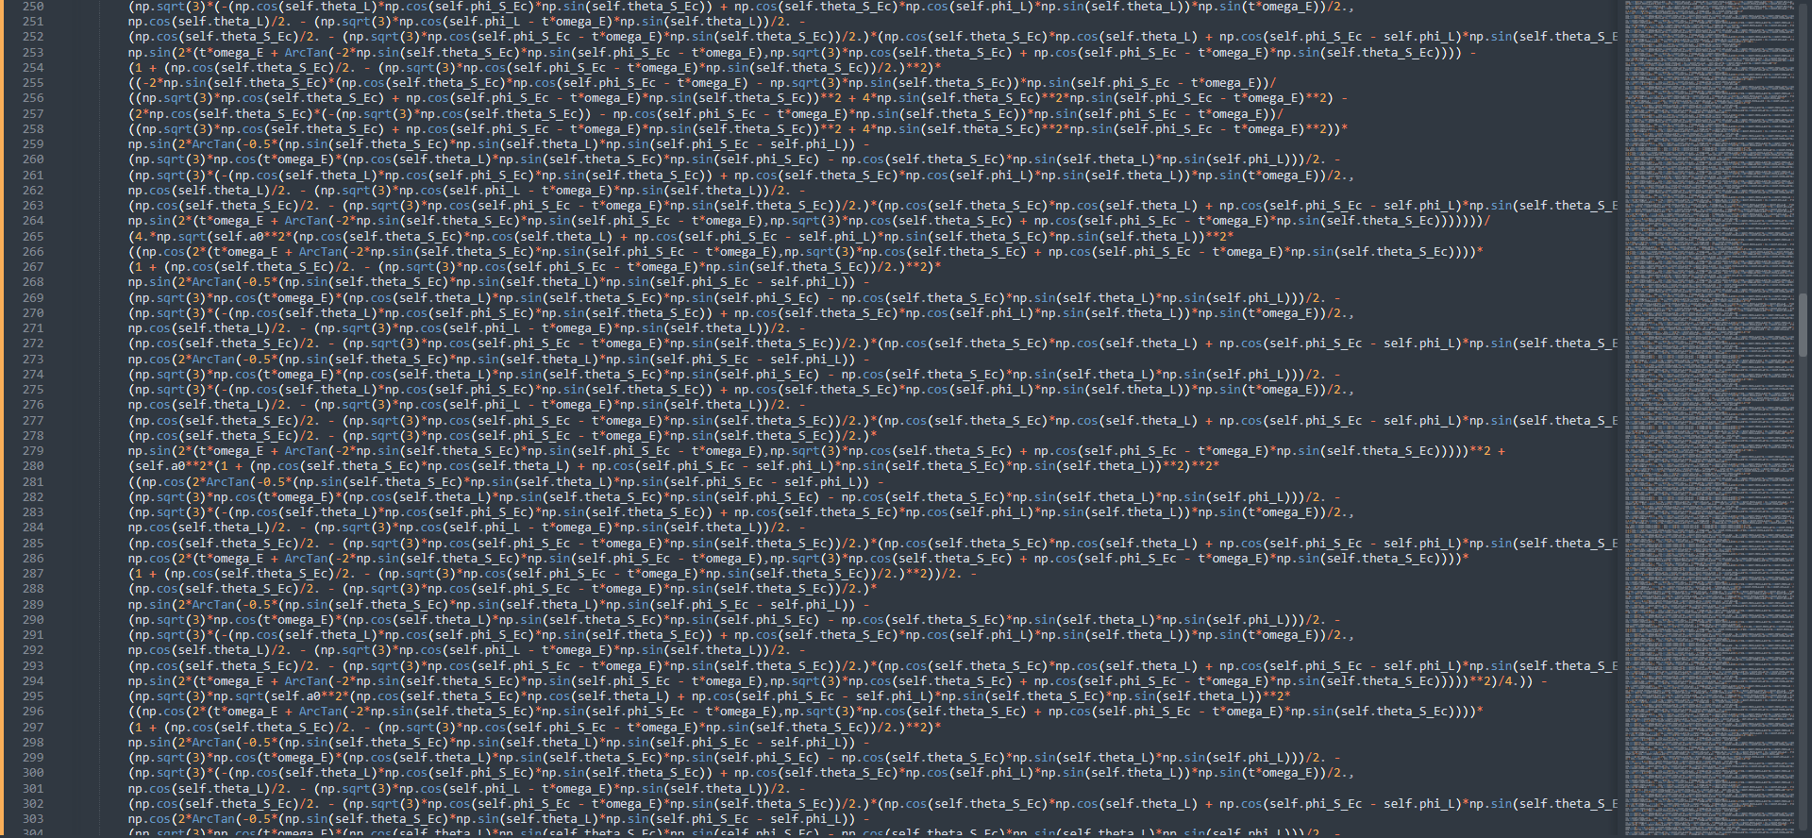
Note that the analytic derivative does exist, but it is a) too long for pretty code – you see a snippet of the 657 lines of terms for $\frac{∂h_{α}}{∂θ_{S}}(t)$ in python code, see delh_delthetaS.txt on Git and…

Slide 10
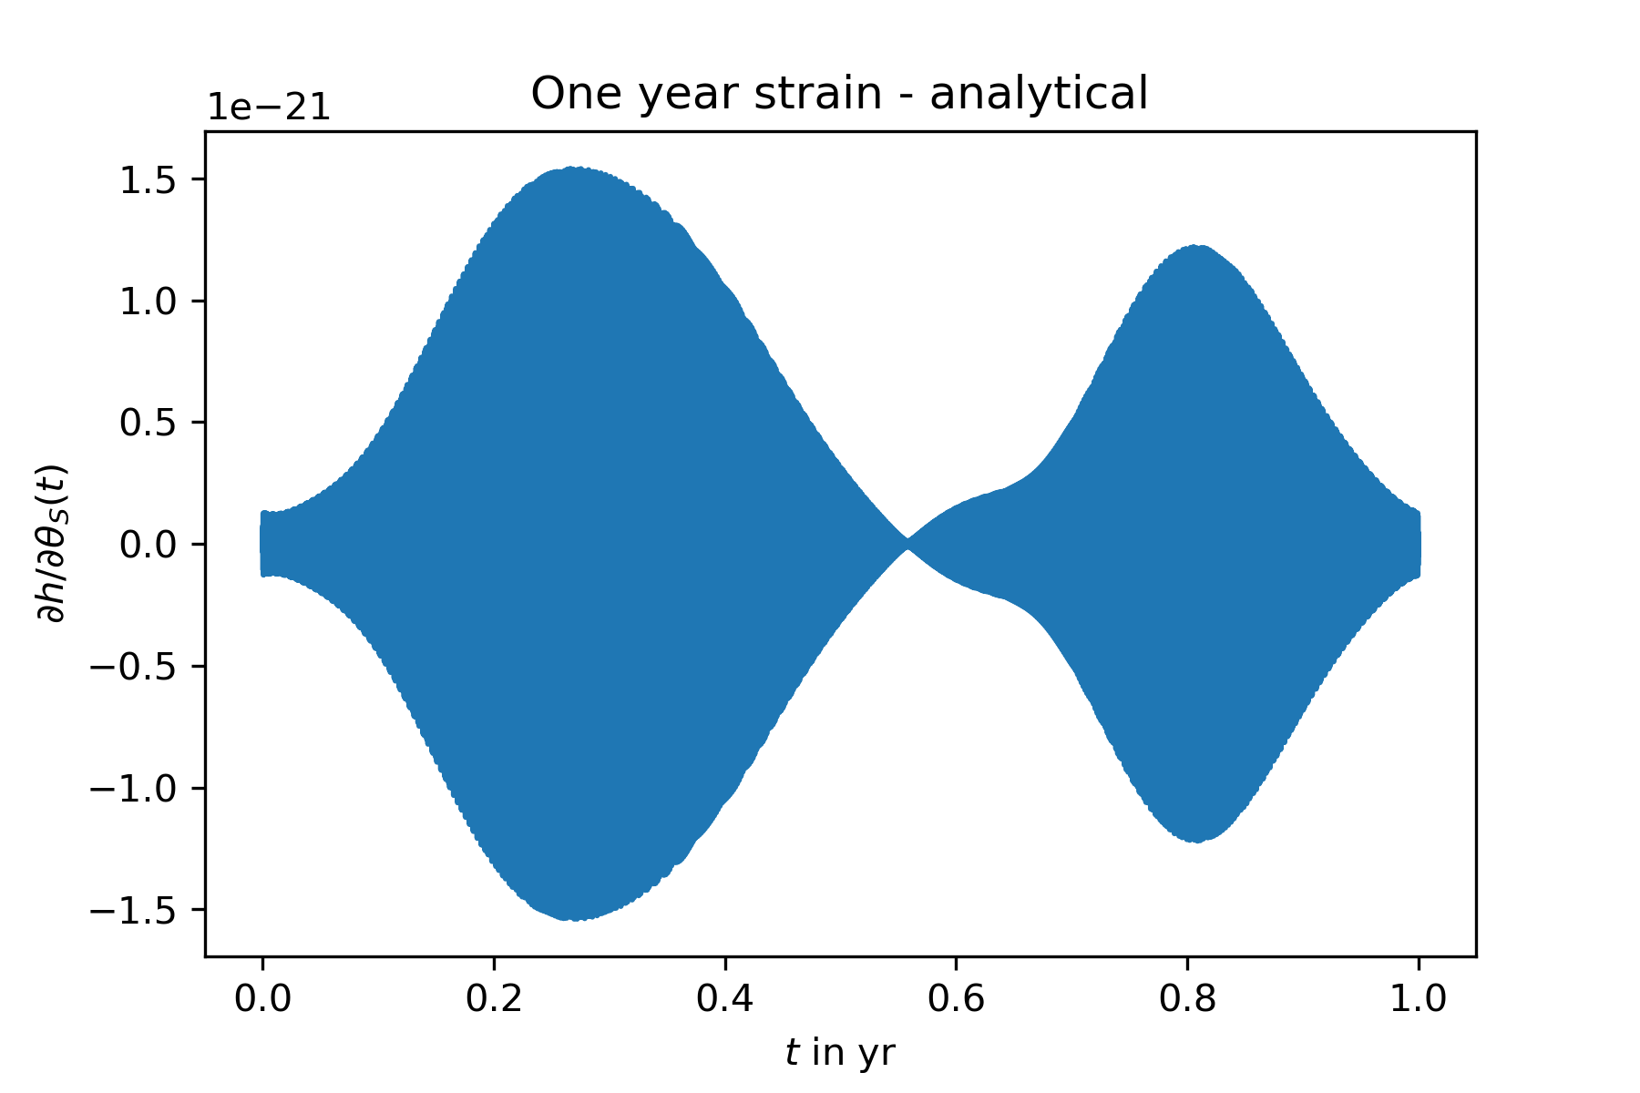
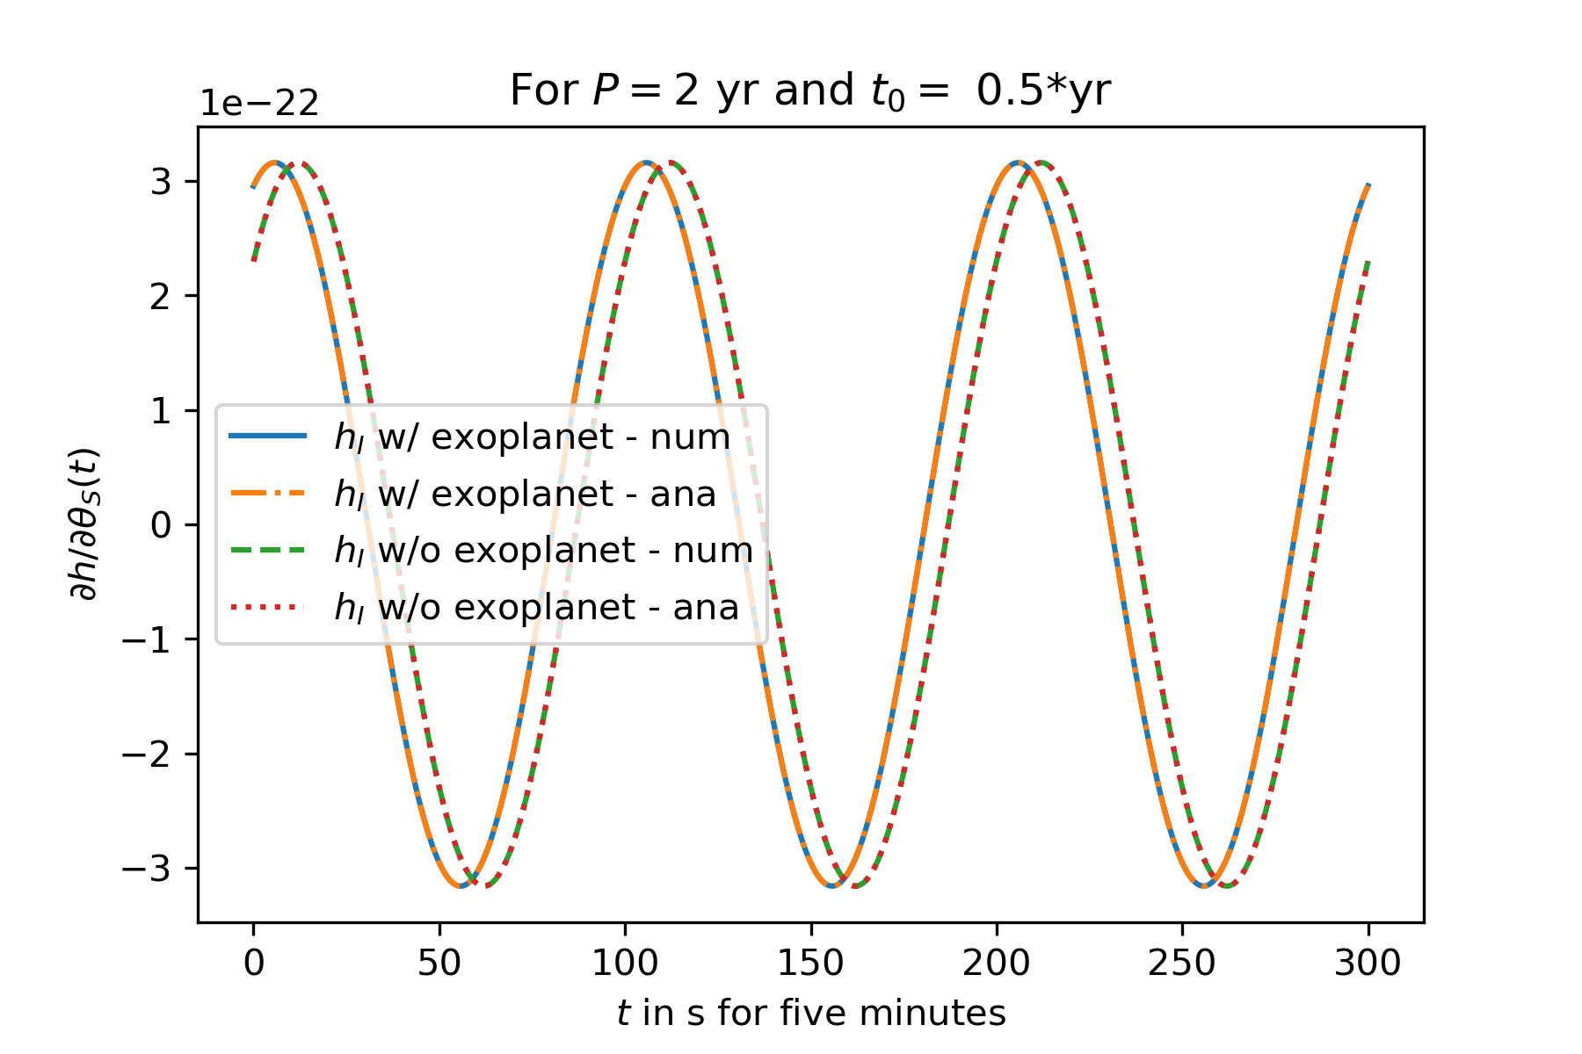
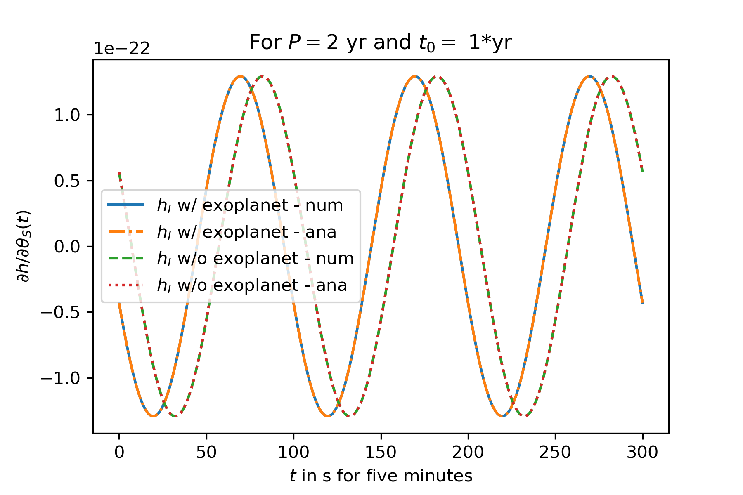
 | Numerical derivative | Analytic derivative
Shape of the Amplitude
Shape of the frequency (1 hour after 0.3*yr)
b) results in the same function anyways, plus…

Slide 11
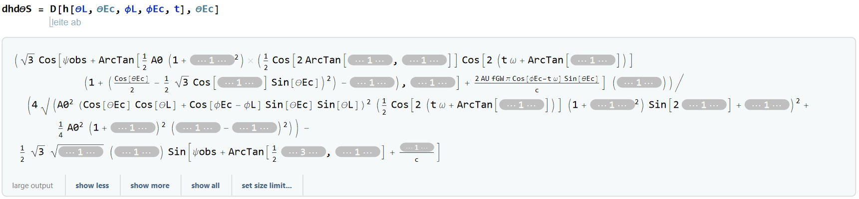
And sadly life would be too easy if we could integrate it analytically :c
c) neither Simplify nor Integrate will return

Slide 12
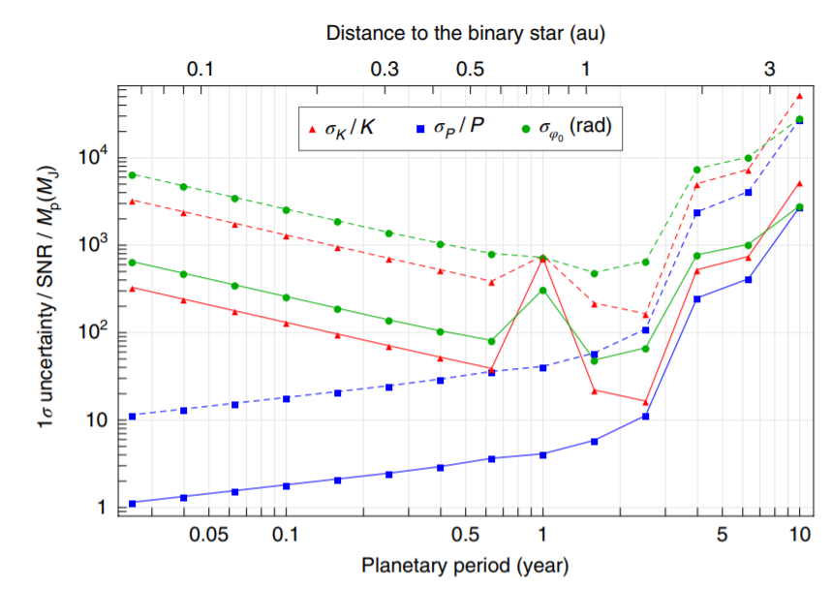
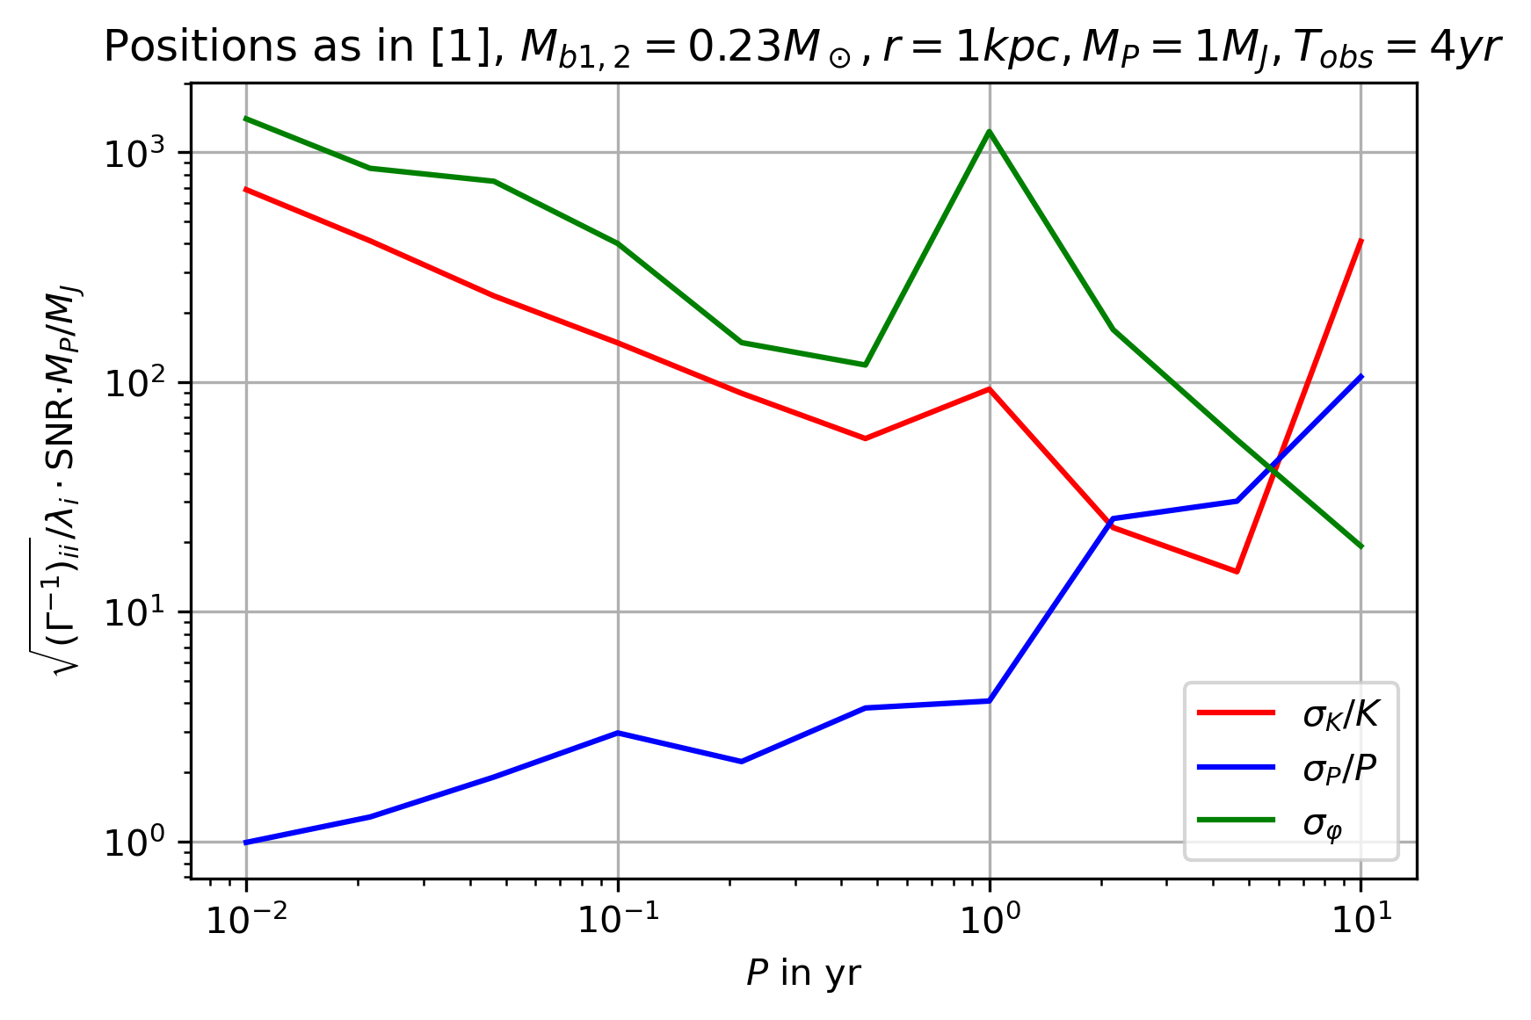
Computing the uncertainties
Sadly it still doesn‘t work, even with higher precision in integration…
At this point I‘m finally going to stop though

Slide 13
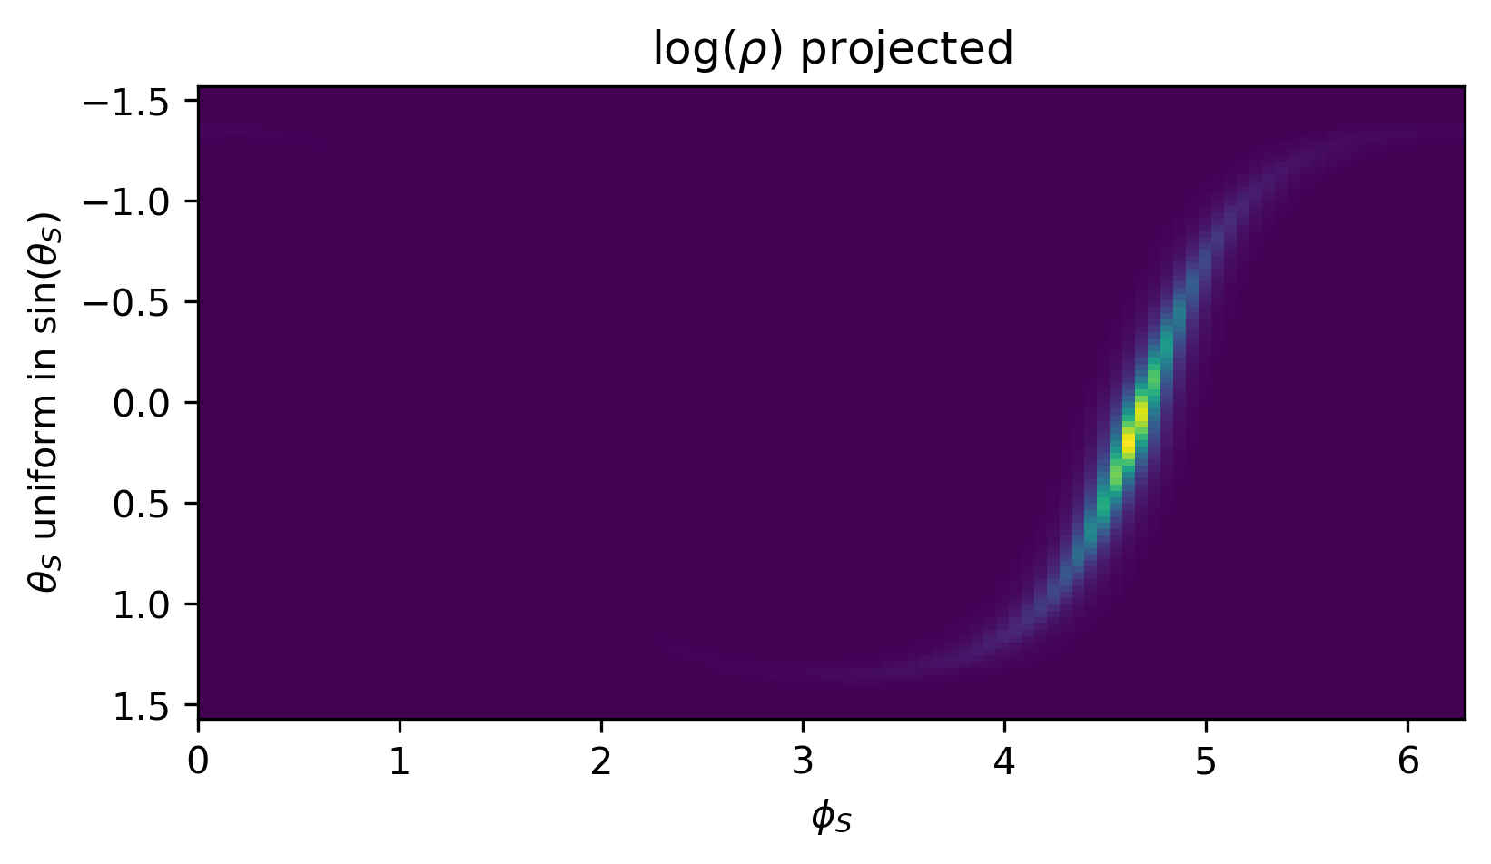
How will the position be a factor for the uncertainty?
Look for a change in uncertainties over relevant region in milky way
x
x
x
x
x

Slide 14
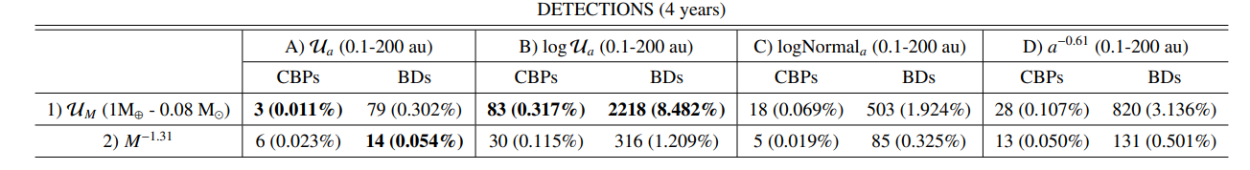
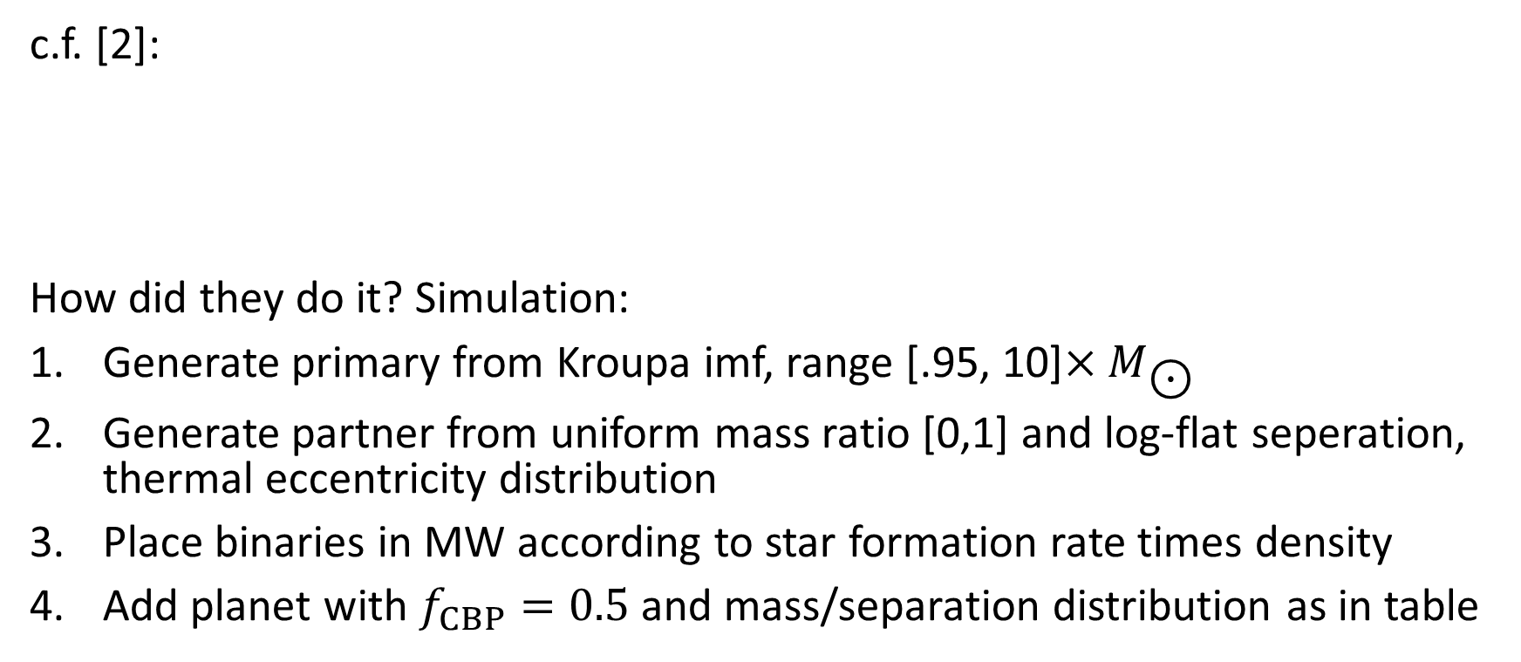
Constraining the number of exoplanets
c.f. [2]:
How did they do it? Simulation:
Generate primary from Kroupa imf, range [.95, 10]${×M}_{\text{⊙}}$
Generate partner from uniform mass ratio [0,1] and log-flat seperation, thermal eccentricity distribution
Place binaries in MW according to star formation rate times density
Add planet with $f_{CBP}=0.5$ and mass/separation distribution as in table

Slide 15
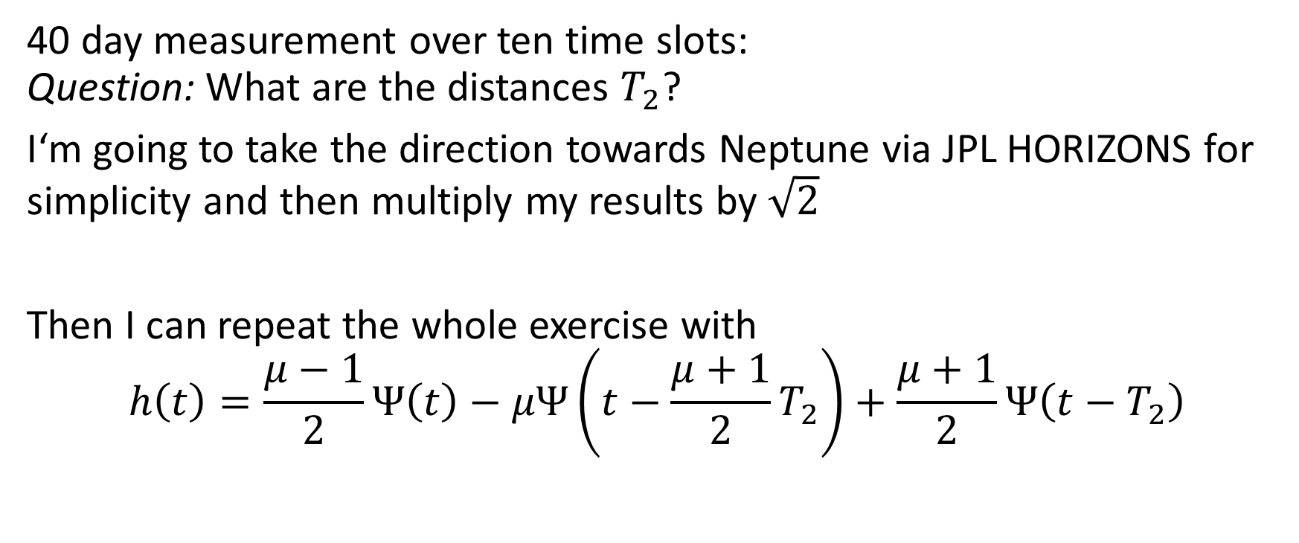
How well will icegiant constrain exoplanets?
40 day measurement over ten time slots: Question: What are the distances $T_{2}$?
I‘m going to take the direction towards Neptune via JPL HORIZONS for simplicity and then multiply my results by $\sqrt{2}$
Then I can repeat the whole exercise with
$$h\left(t\right)=\frac{μ−1}{2}Ψ\left(t\right)−μΨ\left(t−\frac{μ+1}{2}T_{2}\right)+\frac{μ+1}{2}Ψ\left(t−T_{2}\right)$$

Slide 16
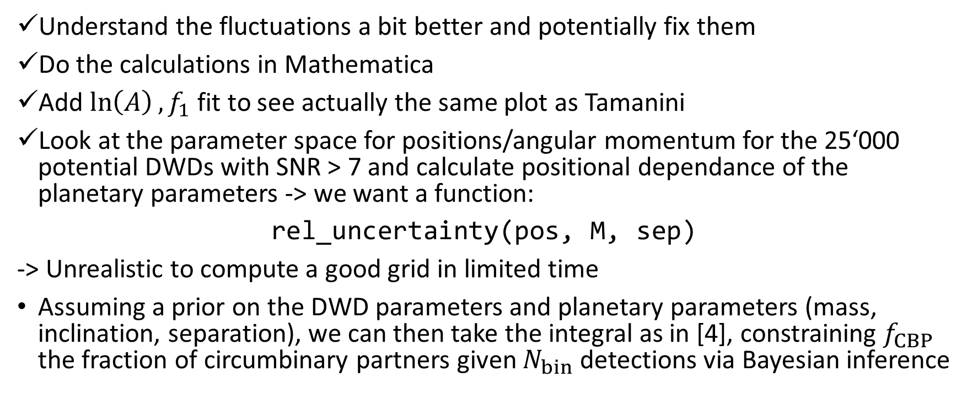
Next milestones
Understand the fluctuations a bit better and potentially fix them
Do the calculations in Mathematica
Add $\ln\left(A\right), f_{1}$ fit to see actually the same plot as Tamanini
Look at the parameter space for positions/angular momentum for the 25‘000 potential DWDs with SNR > 7 and calculate positional dependance of the planetary parameters -> we want a function:
rel_uncertainty(pos, M, sep)
-> Unrealistic to compute a good grid in limited time
Assuming a prior on the DWD parameters and planetary parameters (mass, inclination, separation), we can then take the integral as in [4], constraining $f_{CBP}$ the fraction of circumbinary partners given $N_{bin}$ detections via Bayesian inference

Slide 17
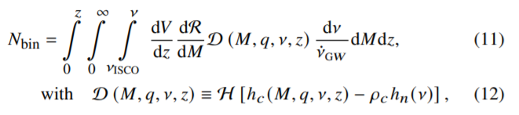
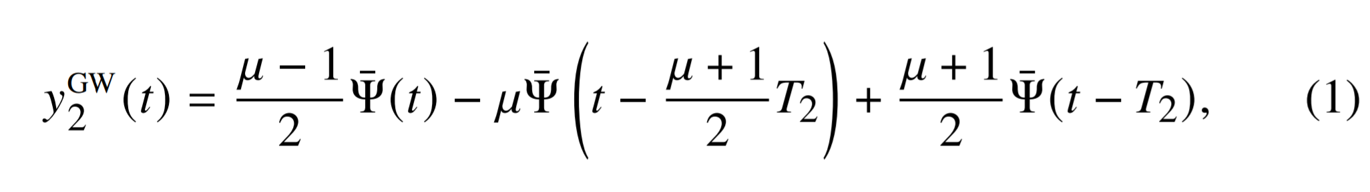
Next milestones
-> already done by Danielsky et al. [2]
Then repeat the exercise with the strain and signal to noise of the IceGiant mission: to see if it could see most promising exoplanet candidates/Jupiter-like planets
Combine measurements of IceGiant and LISA -> just add Fisher information prior to inversion ☺

Slide 18
References
[1] Tamanini, N., Danielski, C. (2019). The gravitational-wave detection of exoplanets orbiting white dwarf binaries using LISA. Nat Astron 3, 858–866. https://doi.org/10.1038/s41550-019-0807-y
[2] Danielski, C., Korol, V., Tamanini, N., & Rossi, E.M. (2019). Circumbinary exoplanets and brown dwarfs with the Laser Interferometer Space Antenna. Astronomy and Astrophysics, 632.
[3] Cutler, C. (1998). Angular resolution of the LISA gravitational wave detector. Physical Review D, 57, 7089-7102.
[4] Soyuer, D., Zwick, L., D’Orazio, D., Saha, P. (2021). Searching for gravitational waves via Doppler tracking by future missions to Uranus and Neptune. MNRAS: Letters, 503, 1, L73-79. https://doi.org/10.1093/mnrasl/slab025
[5] Maggiore, M. (2008). Gravitational Waves Volume 1: Theory and Experiments. Oxford University Press

